Slide 1







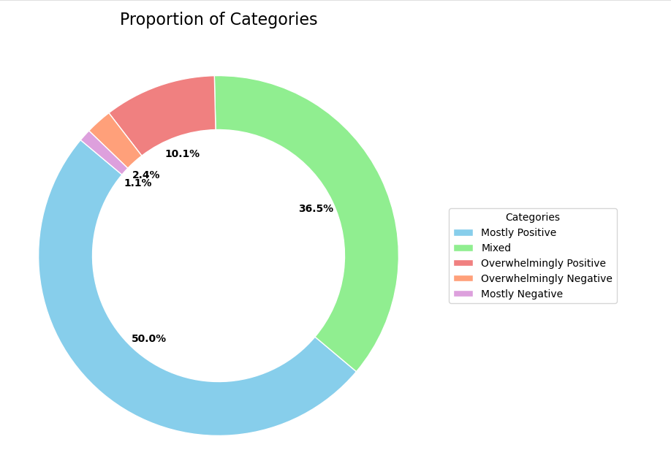
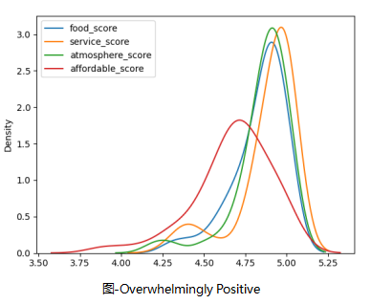
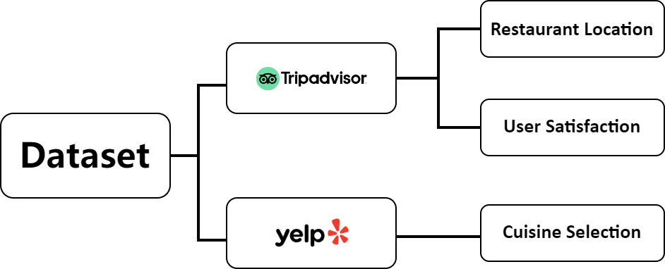


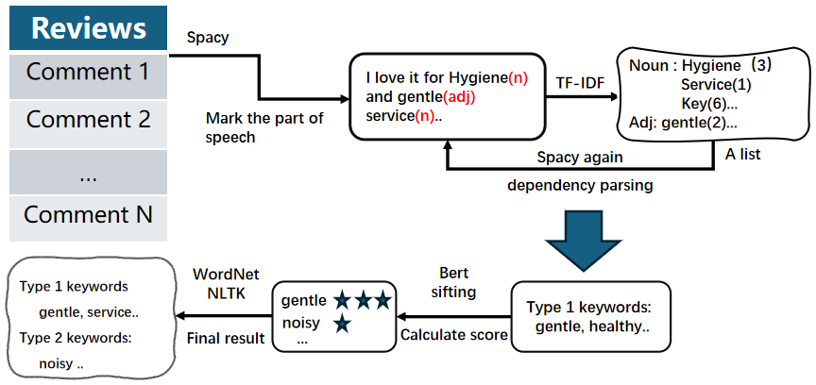
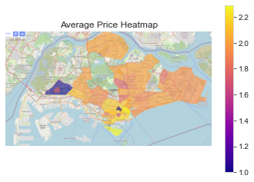
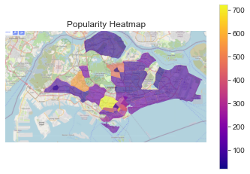
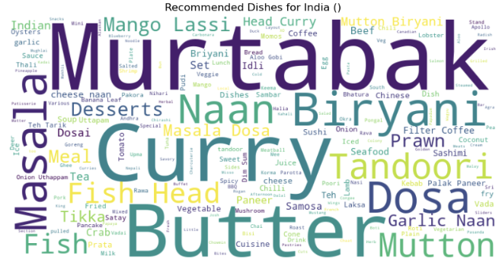


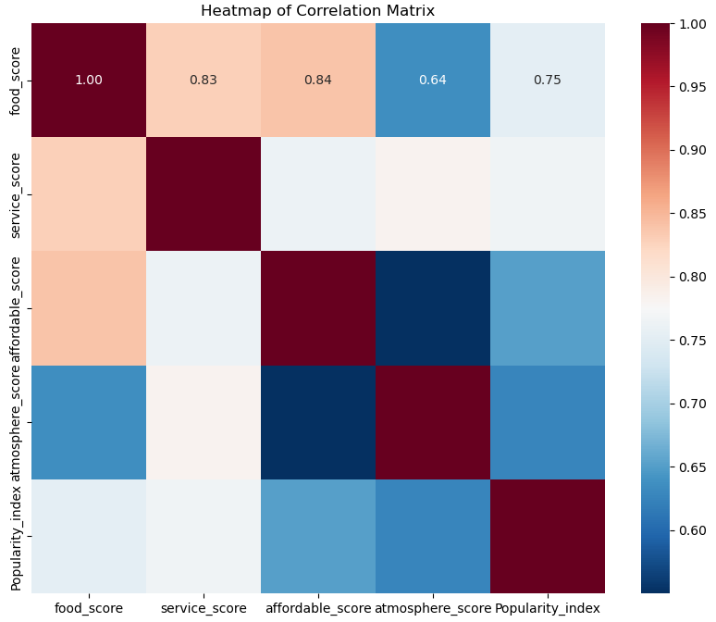



SWS3023 Group 2 Member : He Yunhan,Huang Ziyang,Zou Jingyu Advisor : Lek Hsiang Hui
In the post-pandemic era of economic downturn, opening a restaurant is a highly risky venture. However, restaurants still remain the top choice for both locals and foreign tourists in Singapore when dining out, indicating a vast market potential.
By mining restaurant data from Tripadvisor and yelp, we propose reliable strategies to reduce the risk of restaurant failures and bankruptcies.
Scraping detailed information on ratings and number of reviews for 8,551 restaurants from TripAdvisor and 4,642 reviews from Yelp, we aim to provide reliable strategies for restaurant operators focusing on three key aspects: restaurant location, user satisfaction and cuisine selection.
We explored the characteristics of restaurants with a 90%+ 5star rating, compared them with the average restaurant.
First, We apply TF-IDF to extract key nouns and adjectives. Then use BERT calculates sentiment scores, filtering keywords (positive > 0.23, negative < -0.7). Finally using WordNet and NLTK to generate keywords.
We scraped Tripadvisor data on the average number of reviews, average ratings, and average prices for 8,551 restaurants across 40 regions.
By manually annotating geographic data on LabelMe, we created a Geojson file and used them to generate heatmaps to find out ideal location for a restaurant.
word cloud of
recommended
Indian cuisine
The ratings of food, service, atmosphere, affordability reflect customers' satisfaction with different details of the restaurant.
We used this data to create a heat map and found that food and service have the greatest correlation with restaurant ratings.
● Bukit Batok, Orchard, and Ang Mo Kio are ideal locations
for opening a restaurant.
● To provide customers with the best experience, it's essential
to maintain high quality in food, service, and ambiance, with
no obvious shortcomings.
● Through our system, we can know the most popular cuisine.
it can serve as a reference for opening a restaurant.
● Due to the limited time, there might not be enough samples
under a few labels, resulting in some flaws.
NUS SOC Summer Workshop 2024

